Slide 1


PDEG
PNP Drug Enforcement Group
ACCOMPLISHMENT REPORT
September 27, 2023

Slide 2


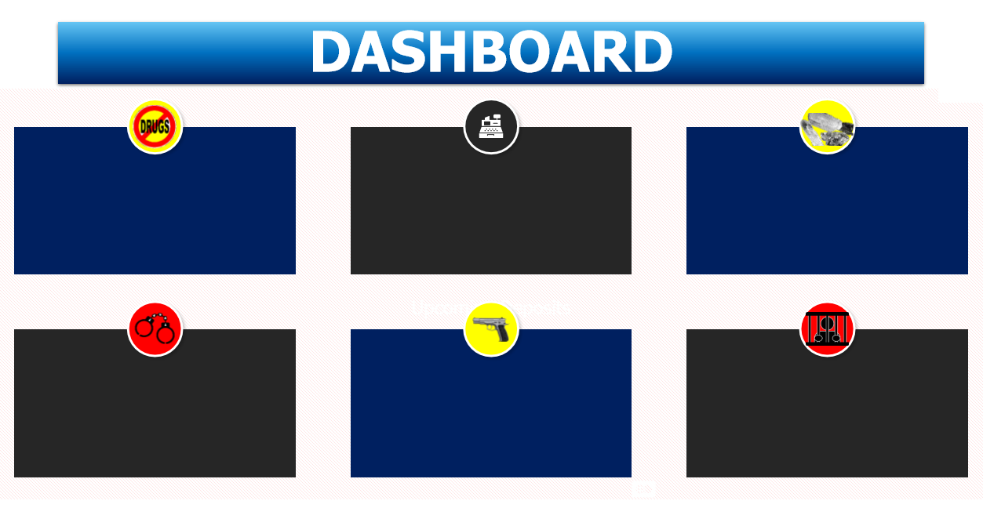
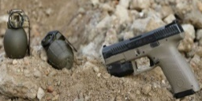

PDEG ACCOMPLISHMENT REPORT
Period Covered: January 1, 2023 to September 27, 2023
260,609,612.00
Total Estimated Standard Drug Price (Php)
661
Drug
Personalities
Arrested
2
DIPOs
574
Operations Conducted
11
Firearms
Confiscated
ILLEGAL DRUGS CONFISCATED
8,855.62 Shabu
(grams)
963,160
Marijuana Plants
(pieces)
46,915.80 Marijuana Dried Leaves
(grams)
1,003
Marijuana Kush
(grams)
5,000
Marijuana Stalks
(grams)
Arrested Minor: 8 out of 661

Slide 3
ACCOMPLISHMENT REPORT
Period Covered: January 1, 2023 to September 27, 2023
Region | Percent | Region | Percent
1 | 3.31 | 9 | 2.26
2 | 3.48 | 10 | 4.01
3 | 6.62 | 11 | 4.36
4A | 11.85 | 12 | 2.79
4B | 0.17 | 13 | 2.61
5 | 4.01 | COR | 4.18
6 | 12.54 | BAR | 0.17
7 | 5.92 | NCR | 29.97
8 | 1.74 | TOTAL
15
Dismantling of Drug DEN Operations Conducted

Slide 4
ACCOMPLISHMENT REPORT
Period Covered: January 1, 2023 to September 27, 2023
ILLEGAL DRUGS CONFISCATED
8,855.62 Shabu
(grams)
963,160
Marijuana Plants
(pieces)
46,915.80 Marijuana Dried Leaves
(grams)
1,003
Marijuana Kush
(grams)
5,000
Marijuana Stalks
(grams)
15
Dismantling of Drug DEN Operations Conducted
Commonly Used:
Shabu
Marijuana (Plants & Dried Leaves)

Slide 5
Thank You and God Bless…
Notes:
Greetings!!!!!!

